Slide 1
Quick and Painless Introduction to Machine Learning
J. Stephen Downie
School of Information Sciences
University of Illinois at Urbana-Champaign
jdownie@illinois.edu
Xiao Hu
Faculty of Education
University of Hong Kong
xiaoxhu@hku.hk

Slide 2
DocD’s Life: A Bunch of Acronyms
IMIRSEL: International Music Information Retrieval Systems Evaluation Laboratory
NEMA: Networked Environment for Music Analysis
ISMIR: International [Symposium | Conference | Society] [on | for] Music Information Retrieval
MIREX: Music Information Retrieval Evaluation eXchange

Slide 3
Dr. Hu: A Graph
Data Science
Learning Analytics
HKU
Music Information Retrieval
Computer Science
Illinois
Electrical Engineering
Wuhan Univ.
Artificial intelligence
Machine learning
Beijing Univ. of Posts and Telecom.

Slide 4
Agenda
Million Mile View of Machine Learning
Machine learning and Data Science
Supervised vs. unsupervised learning
Decision Tree; Support Vector Machines (SVM); K-Nearest Neighbor (kNN)
Experimentation
Friendly ML Tools:
Weka: Machine learning
RapidMiner: Data mining
Case Studies
Audio Music Mood Classification Experiments (supervised)
Mood Label Clustering (unsupervised)
Wrap Up and Discussion

Slide 5
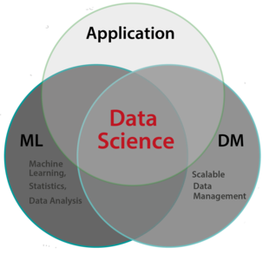
Machine Learning and Data Science
Data Science
Data analytic thinking
Decision supporting
Discovery-based
Data management:
Our Spring Institute in Feb. 2015
Machine learning
Methods of big data analysis
Automated discovery from data
Hypothesis generation
Statistics
Hypothesis testing
Image credit: Berlin Big Data Center
Notes:
Data mining is research

Slide 6
Examples of ML
Spam email detector
Recommender systems
Fraud detection
Categorizing news stories as finance, weather, entertainment, sports, etc.
Categorizing library materials by catalogs
Categorizing music by mood
Decide whether to play golf according to weather conditions
Market segmentation
Group library patrons into different clusters

Slide 7
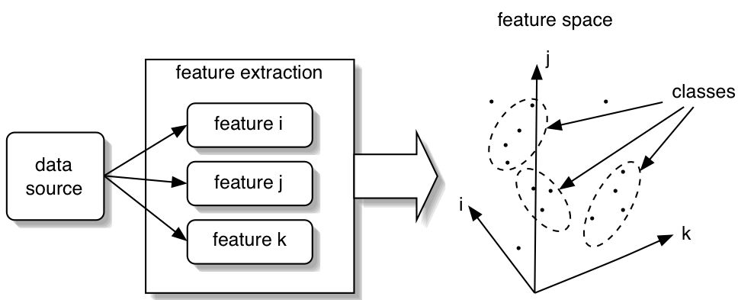
Machine Learning in One Slide
Notes:
Data is processed to extract features for each data object. These features can be conceptualized as dimensions, and each data object can be conceptualized as a vector in this space. Classification consists of partitioning this space in useful ways that reflects some notion of similarity of the data objects.

Slide 8
Supervised vs. Unsupervised Learning
Supervised
Manually label a subset of the data objects
Use those class labels to “train” a machine learning algorithm: GROUNDTRUTH
Train/Test experiments
Unsupervised
Choose distance metric (e.g., Euclidian distance)
Choose (or don’t) number of classes
Partition into classes that minimize within-class distance and maximize between-class distance

Slide 9
Common Methods
Supervised
Unsupervised
Decision trees
Random forests
Support vector machines
Bayesian
Neural networks
Nearest neighbor
…
K-means clustering
Mixture model clustering
Hierarchical clustering
Matrix factorizations
….

Slide 10
Input Data: Supervised
Item of Interest | GROUNDTRUTH CLASS | Feature1 | Feature2 | FeatureX
ObjectName1 | Label1 | Value1 | Value2 | ValueX
ObjectName2 | Label2 | Value1 | Value2 | ValueX
ObjectNameX | Label3 | Value1 | Value2 | ValueX
Bird (Band #) | SPECIES | Height (cm) | Mass (kg) | Colour
1 | Daffy | 25 | 0.75 | Black
2 | Woody | 30 | 1 | Brown
3 | Big | 300 | 200 | Yellow

Slide 11
Input Data: Unsupervised
Item of Interest | Feature1 | Feature2 | FeatureX
ObjectName1 | Value1 | Value2 | ValueX
ObjectName2 | Value1 | Value2 | ValueX
ObjectNameX | Value1 | Value2 | ValueX
Bird (Band #) | Height (cm) | Mass (kg) | Colour
1 | 25 | 0.75 | Black
2 | 30 | 1 | Brown
3 | 300 | 200 | Yellow

Slide 12
Classification Methods
Supervised learning
Decision Tree
Support Vector Machines (SVM)
K-Nearest Neighbor (kNN)

Slide 13
Illustrating Classification Task
Two steps
Notes:
Induction = build the model; deduction: use the model to predict on unseen (new) instances

Slide 14
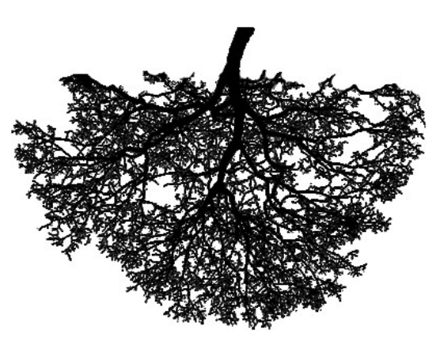
What is a Decision Tree?
The classification model is represented as a tree
Each node represents a decision based on one attribute of data
Given a new instance of the problem, following a path in the tree will give a class label
Refund
Yes
No
NO
MarSt
Single, Divorced
Married
TaxInc
NO
< 80K
> 80K
NO
YES

Slide 15
An Example of Decision Tree
Problem: to label each person as to whether they will cheat on their income tax
Class
label
Splitting Attributes
Refund
Yes
No
NO
MarSt
Single, Divorced
Married
TaxInc
NO
< 80K
> 80K
NO
YES
Training Data
Model: Decision Tree
Notes:
This is a very simplified EXAMPLE. It is meant to illustrate the idea.

Slide 16
Decision Tree Classification Task
Decision Tree

Slide 17
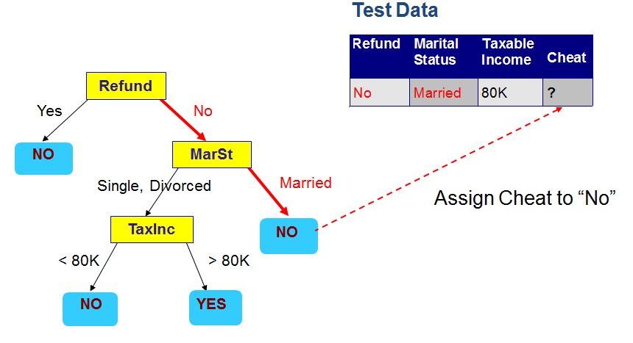
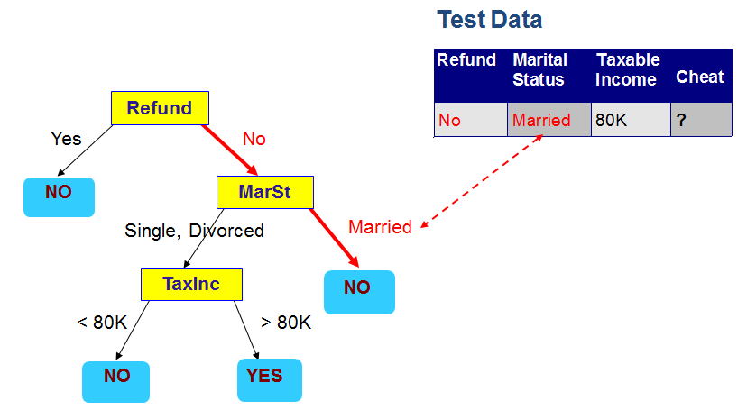
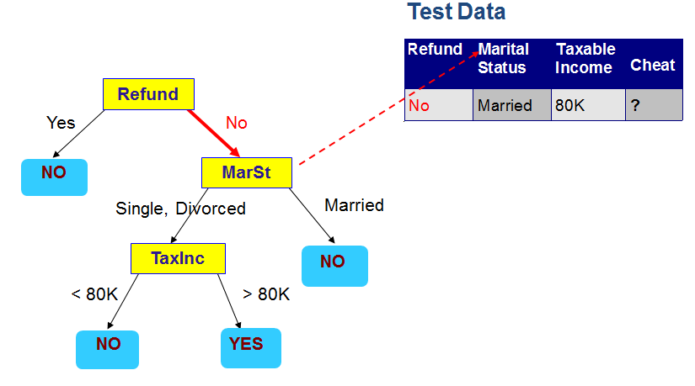
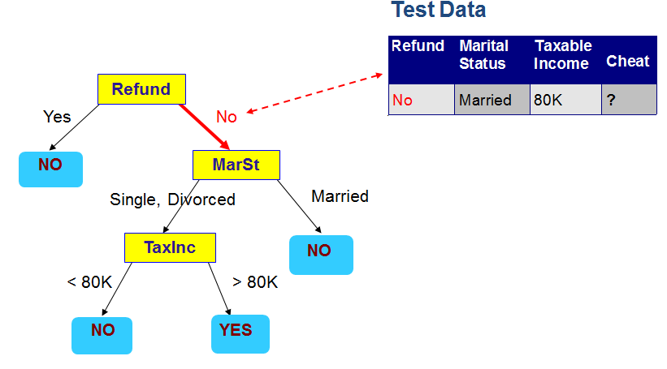
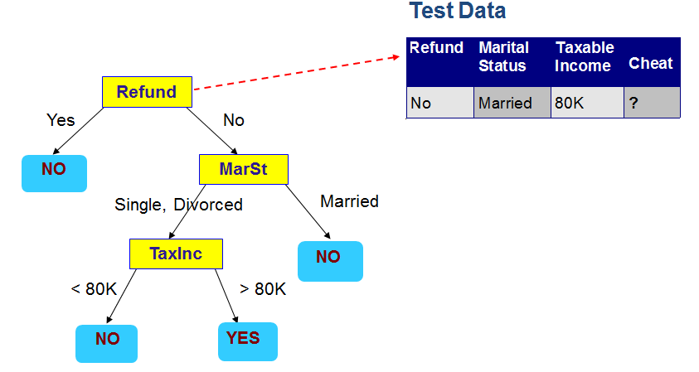
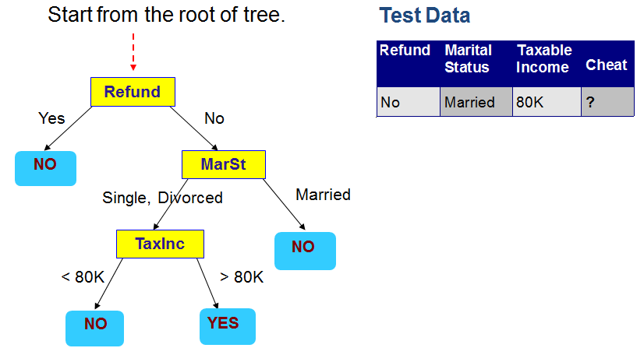
Apply Model to Test Data

Slide 18
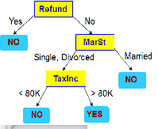
Decision Trees as Classifiers
Strengths
One of the most popular data mining tools
Easy to understand
important for model evaluation and communication to non-DM-savvy stakeholders
Computationally cheap
Almost all data mining packages include DTs
Weakness
Trees grow too big when there are many features
Cannot output probabilities of predictions

Slide 19
Support Vector Machines
SVM

Slide 20
Support Vector Machines
Separate the data using a linear decision boundary (a line)
There are quite many possible solutions
Which one is better?
How do you define “better”?

Slide 21
Support Vector Machines
Find a boundary that maximizes the margin for both classes => B1 is better than B2
If an unknown data
is here, B2 will classify it to the wrong class whereas B1 will get it correct.
Notes:
Why the margin matters? Because you don’t know where the unknown data will appear, and thus a bigger margin would have more chance to classify unknown data correctly. See B2 in the above picture as an example.

Slide 22
Support Vectors
Support vectors
Support vectors are the training examples that are located on the margins
Only support vectors determine the decision boundary (so SVM is a fast algorithm)
Notes:
Samples on the margin are called support vectors. This is how the name Support vector machines is from.

Slide 23
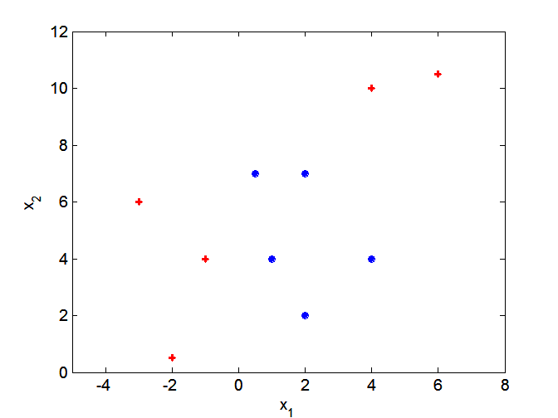
Nonlinear Support Vector Machines
What if decision boundary is not linear?

Slide 24
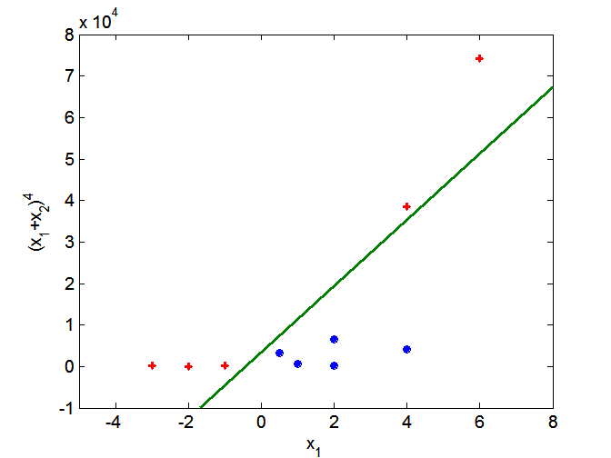
Nonlinear Support Vector Machines
Transform data into higher dimensional feature space
Such transformation is done through a “kernel” function
Linear SVM is the SVM with a linear kernel
Notes:
Note the vertical axis is a higher order function of x2, this is what it means to transfer the original data into higher dimensional feature space

Slide 25
SVMs as Classifiers
Strength
High tolerance to noisy data
Flexibility in data representation
Probabilistic prediction result
Scalability: successful on extremely large problems
Successful on a wide array of real-world data
Weakness
Require a number of parameters for each kernel type
Interpretability
Easy interpretation for linear kernel
Difficult to interpret the model generated by nonlinear kernels

Slide 26
k-NN: Instance-based learning
In contrast to learning methods that construct a general, explicit target function when training examples are provided, e.g. decision tree, SVM
Instance-based learning methods simply store the training examples during training process
Sometimes called “lazy” learners because they build no model (function) and delay processing the training data until new examples must be classified.
Notes:
In instance-based learning, no model (functions) is built

Slide 27
K-Nearest Neighbor (k-NN)
K-NN: an instance-based learning method
Training process:
Add in all training examples
Classification process:
Given a new example x (uncolored in the picture below), compare the similarity between x and all training examples, choose the majority-voted category label in the k nearest training examples
K=1, prediction=blue
K=2, prediction=?
K=3, prediction=red
Notes:
Note: in the training process, no model (function) is built.
When K= 1, prediction is blue because only the closest example to the new sample is considered, and the closest example is blue
When k = 2, there is a tie
When k =3, the closest three examples are 2 red and 1 blue. The majority is red.

Slide 28
kNN as classifier
Strengths
No assumptions: all depends on the distance between data examples
Simple
Weakness
Sensitive to noisy training data
If your nearest neighbor’s label is wrong…
Cost of classifying new instances can be high
Nearly all computation takes place at classification time rather than when the training examples are first encountered.
Has to search all examples to retrieve the k nearest examples
Notes:
K-NN is a very popular method, often used in comparison to other classification methods.

Slide 29
Experimentation
N-Fold Cross-validation
Not “fair” to train model, then test the model using the same data
Need to have separate TRAIN and TEST data
Problem: groundtruth data can be hard to create limiting amount available with which to train then test
Cross-validation splits one collection into n-fold distinct sets
Model built with one of the subsets held back for testing
Different subset held back each of n-fold subsets
Results averaged

Slide 30
Partition Data Into Training and Test Sets
challenges:
what if by accident you selected a particularly easy/hard test set?
Do you have an idea of the variation in model accuracy due to different training datasets?
Graph credit: Foster Provost in New York University

Slide 31
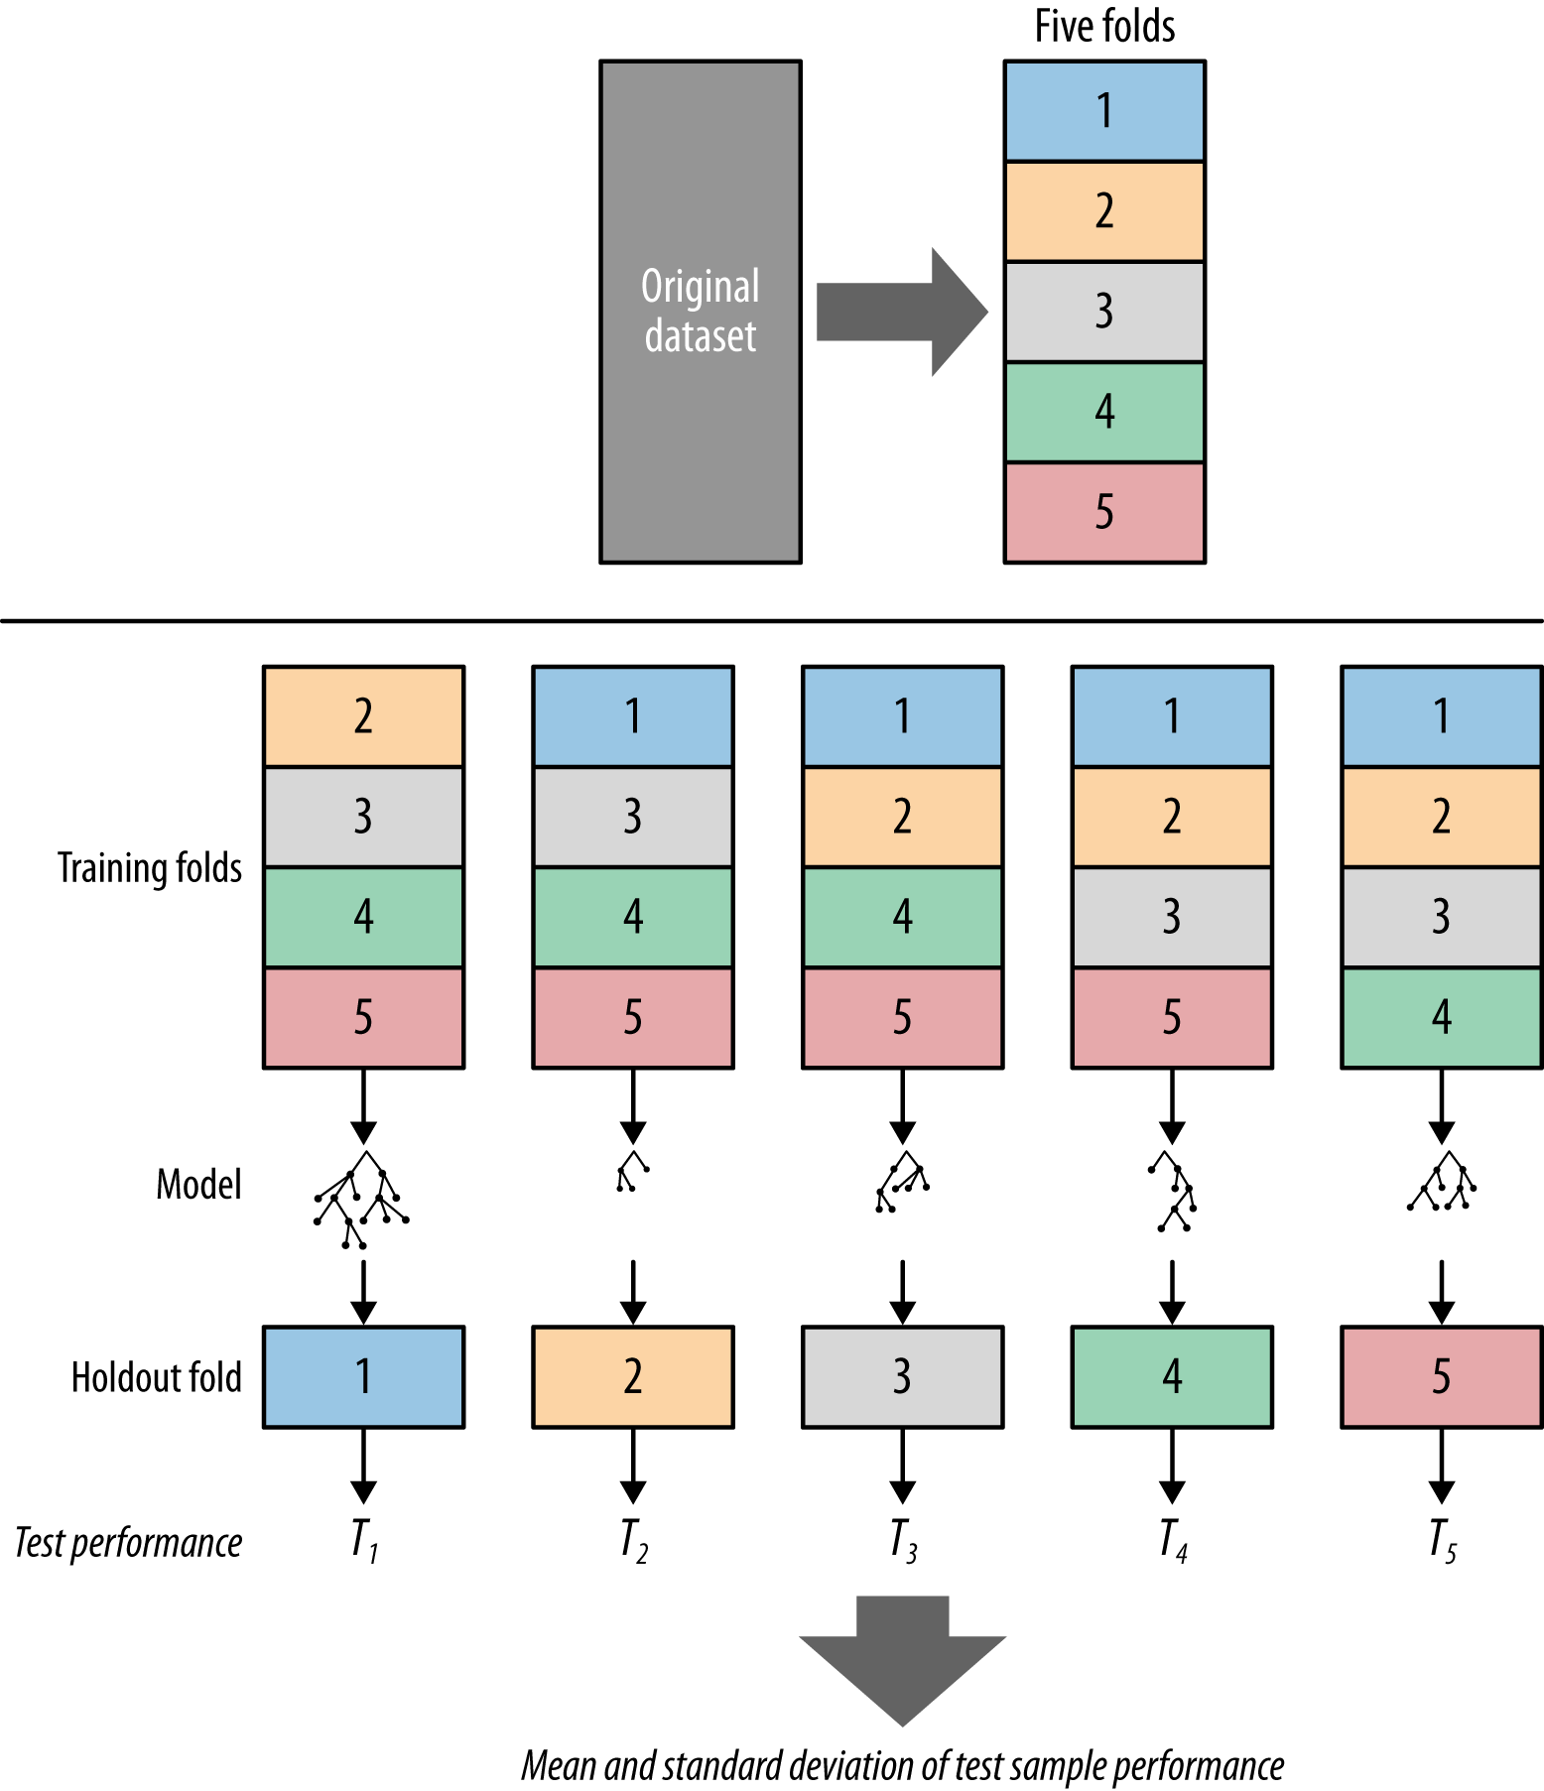
Cross-Validation (CV)
Five-fold CV
Final performance
= average (T₁,…T₅)
Graph credit: Foster Provost in New York University

Slide 32
3-Fold Example
Fold #1
FILE | GROUNDTRUTH MOOD | SPLIT | ROLE
m000001.wav | Wistful_brooding | A | TEST
m000002.wav | Cheerful_fun | A | TEST
m000003.wav | Silly_quirky | A | TEST
m000004.wav | Silly_quirky | A | TEST
m000005.wav | Wistful_brooding | A | TEST
m000006.wav | Rousing_rowdy | B | TRAIN
m000007.wav | Wistful_brooding | B | TRAIN
m000008.wav | Wistful_brooding | B | TRAIN
m000009.wav | Rousing_rowdy | B | TRAIN
m000010.wav | Rousing_rowdy | B | TRAIN
m000011.wav | Cheerful_fun | C | TRAIN
m000012.wav | Wistful_brooding | C | TRAIN
m000013.wav | Silly_quirky | C | TRAIN
m000014.wav | Firey_intense | C | TRAIN
m000015.wav | Silly_quirky | C | TRAIN

Slide 33
3-Fold Example
Fold #2
FILE | GROUNDTRUTH MOOD | SPLIT | ROLE
m000001.wav | Wistful_brooding | A | TRAIN
m000002.wav | Cheerful_fun | A | TRAIN
m000003.wav | Silly_quirky | A | TRAIN
m000004.wav | Silly_quirky | A | TRAIN
m000005.wav | Wistful_brooding | A | TRAIN
m000006.wav | Rousing_rowdy | B | TEST
m000007.wav | Wistful_brooding | B | TEST
m000008.wav | Wistful_brooding | B | TEST
m000009.wav | Rousing_rowdy | B | TEST
m000010.wav | Rousing_rowdy | B | TEST
m000011.wav | Cheerful_fun | C | TRAIN
m000012.wav | Wistful_brooding | C | TRAIN
m000013.wav | Silly_quirky | C | TRAIN
m000014.wav | Firey_intense | C | TRAIN
m000015.wav | Silly_quirky | C | TRAIN

Slide 34
3-Fold Example
Fold #3
FILE | GROUNDTRUTH MOOD | SPLIT | ROLE
m000001.wav | Wistful_brooding | A | TRAIN
m000002.wav | Cheerful_fun | A | TRAIN
m000003.wav | Silly_quirky | A | TRAIN
m000004.wav | Silly_quirky | A | TRAIN
m000005.wav | Wistful_brooding | A | TRAIN
m000006.wav | Rousing_rowdy | B | TRAIN
m000007.wav | Wistful_brooding | B | TRAIN
m000008.wav | Wistful_brooding | B | TRAIN
m000009.wav | Rousing_rowdy | B | TRAIN
m000010.wav | Rousing_rowdy | B | TRAIN
m000011.wav | Cheerful_fun | C | TEST
m000012.wav | Wistful_brooding | C | TEST
m000013.wav | Silly_quirky | C | TEST
m000014.wav | Firey_intense | C | TEST
m000015.wav | Silly_quirky | C | TEST

Slide 35
About Our Tools
Weka
Machine Learning Group at the University of Waikato, Hamilton, New Zealand
http://www.cs.waikato.ac.nz/ml/weka/
Has EXCELLENT associated book
Witten, I., E. Frank, and M. Hall (2011). Data Mining: Practical Machine Learning Tools and Techniques, Third Edition. New York: Morgan Kaufmann.
http://www.amazon.com/exec/obidos/ASIN/0123748569/departmofcompute
RapidMiner
Covers most common machine learning techniques and utilities
https://my.rapidminer.com/nexus/account/index.html#downloads
Has an associated book
Data Mining for the Masses
http://docs.rapidminer.com/downloads/DataMiningForTheMasses.pdf

Slide 36
Case Study 1
Music Mood Classification
Supervised Learning

Slide 37
About our Mood Data
Create by Xiao Hu
Now Dr. Hu, Assistant Professor, University of Hong Kong
Audio Mood Classification (AMC) in MIREX
600 sample song files drawn from MIREX collection
Data represents five “mood clusters”
Each cluster encapsulates a range of related mood terms
Groundtruth generated by volunteers
At least volunteers per song
Mood declared if 2 or 3 volunteers independently assigned cluster
One mood cluster per song

Slide 38

Mood Clusters
Cluster_1: Rousing_rowdy
passionate, rousing, confident, boisterous, rowdy
Cluster_2: Cheerful_fun
rollicking, cheerful, fun, sweet, amiable/good natured
Cluster_3: Wistful_brooding
literate, poignant, wistful, bittersweet, autumnal, brooding
Cluster_4: Silly_quirky
humorous, silly, campy, quirky, whimsical, witty, wry
Cluster_5: Firey_intense
aggressive, fiery, tense/anxious, intense, volatile, visceral

Slide 39

What are the Features?
Bird (Band #) | SPECIES | Height (cm) | Mass (kg) | Colour
1 | Daffy | 25 | 0.75 | Black
2 | Woody | 30 | 1 | Brown
3 | Big | 300 | 200 | Yellow
mp3
numbers
Digital Music Audio Processing

Slide 40
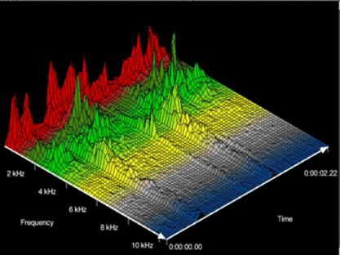
Digital Music Audio Processing
Grows out of digital signal processing and speech recognition research
Feature extraction mostly from Fast Fourier Transforms (FFT) and Mel Frequency Cepstral Coefficients (MFCC)

Slide 41
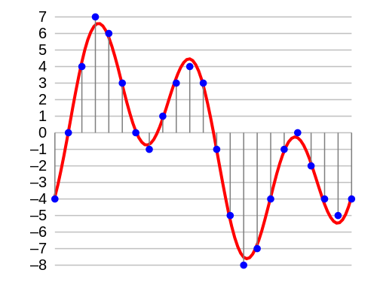
Music Digital Audio
http://en.wikipedia.org/wiki/Digital_audio

Slide 42
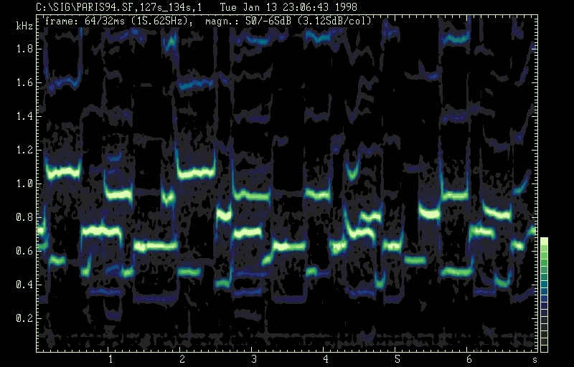
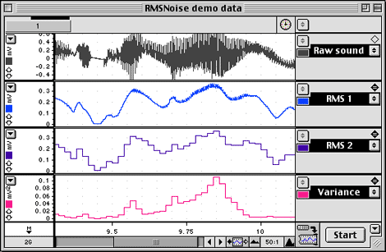
Audio: Two Domain Problem
Frequency domain
Time domain

Slide 43
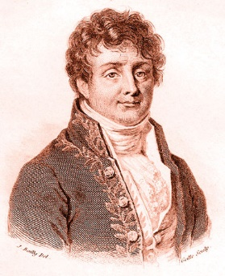
Our Hero
Jean-Baptiste Joseph Fourier
Mathematician and physicist
Born: 21 March 1768
Died: 16 May 1830
Most famous for his spiffy “Fourier Transform” and related “Fourier’s Law”
Also noted for early “greenhouse effect” work!
https://upload.wikimedia.org/wikipedia/commons/a/aa/Fourier2.jpg
By User:Bunzil at en.wikipedia [Public domain], from Wikimedia Commons

Slide 44
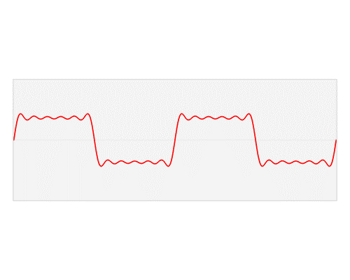
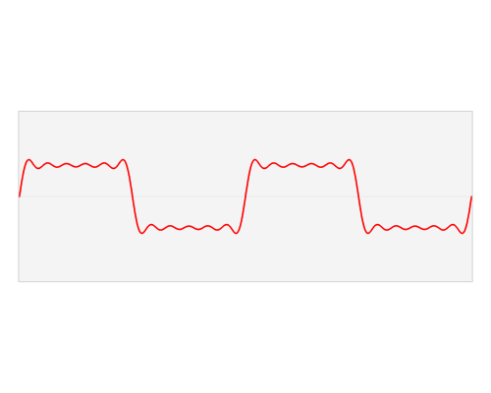
From Wave to Data
There are a number of tools
e.g., jAudio
Professor Corey McKay,
Marianopolis College, Montreal, QC
http://jmir.sourceforge.net/index_jAudio.html
Part of the jMIR suite developed at McGill University
http://jmir.sourceforge.net/
mp3
jAudio
features
http://en.wikipedia.org/wiki/User:LucasVB/Gallery

Slide 45
Classification Results (1)
Confusion matrix
Performance measures
 | PREDICTED CLASS
ACTUAL CLASS |  | Class=Yes | Class=No
 | Class=Yes | a | b
 | Class=No | c | d
a: TP (true positive)
b: FN (false negative)
c: FP (false positive)
d: TN (true negative)

Slide 46
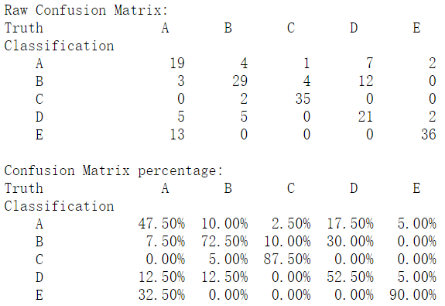
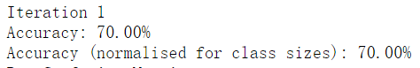
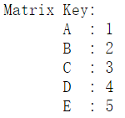
Classification Results (2)
MIREX 2007
http://www.music-ir.org/mirex/results/2007/am_tzan.eval.txt
Winner system: GT: George Ttzanetakis, University of Victoria, Canada
Classification Model: Support Vector Machine (SVM)

Slide 47
Case Study 2
The Five Mood Clusters
Unsupervised Learning

Slide 48
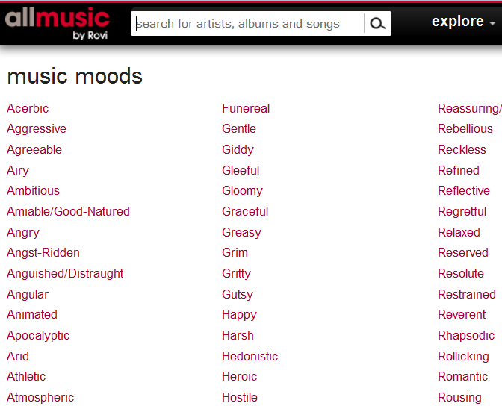
Editorial Mood Labels on allmusic.com
Given by professional editors of online repositories
Have a certain level of control
- Rooted in realistic social contexts
allmusic.com: “the most comprehensive music reference source on the planet”
288 mood labels created and assigned to music works

Slide 49
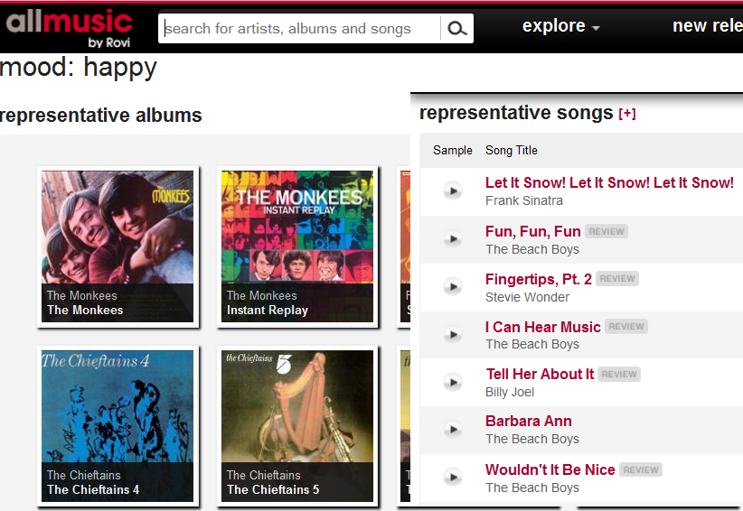

Slide 50
Distance between Labels
 | Album_1 | Album_2 | Album_3 | Album_4 | ….
Happy | 1 | 0 | 1 | 0 | …
Angry | 0 | 1 | 0 | 1 | …
Gloomy | 0 | 0 | 1 | 0 | …
… | … | … | … | … | …
 | Song_1 | Song_2 | Song_3 | Song_4 | ….
Happy | 1 | 0 | 1 | 0 | …
Angry | 0 | 1 | 0 | 1 | …
Gloomy | 0 | 0 | 1 | 0 | …
… | … | … | … | … | …

Slide 51
Distance between Two Data Samples
Vector representation
Vector: a row in a data table (a₁, a₂, … a_{n})
Model the problem as a n-dimensional space for n attributes
In the mood label problem, each data sample can be considered a vector, where the dimensions are as follows: Album_1 ; Album_2 ; Album_3; …
and an sample vector could be ( 0, 1, 1,….)
Represented in a 3-dimensional space
Album_1
Album_2
1
1
(0, 1, 1 )
0
Album_3
1
Notes:
Model the problem as an n-dimensional space for n attributes

Slide 52
Distance between Two Data Samples
Distance/similarity measures
Euclidean distance
a=(1,2)
b=(4,2)
d
α

Slide 53
Unsupervised Learning: Clustering
A clustering is a set of clusters
Finding groups of objects such that the objects in a group will be similar to one another and different from the objects in other groups
Intra-cluster distances are minimized
Inter-cluster distances are maximized

Slide 54
Unsupervised Learning: Clustering
Two major kinds of methods
hierarchical and partitional sets of clusters
Partitional Clustering
A division of data objects into non-overlapping subsets (clusters) such that each data object is in exactly one subset
Hierarchical clustering
A set of nested clusters organized as a hierarchical tree

Slide 55
Partitional Clustering
Original Points
A Partitional Clustering

Slide 56
Hierarchical Clustering
Hierarchical Clustering
Dendrogram

Slide 57
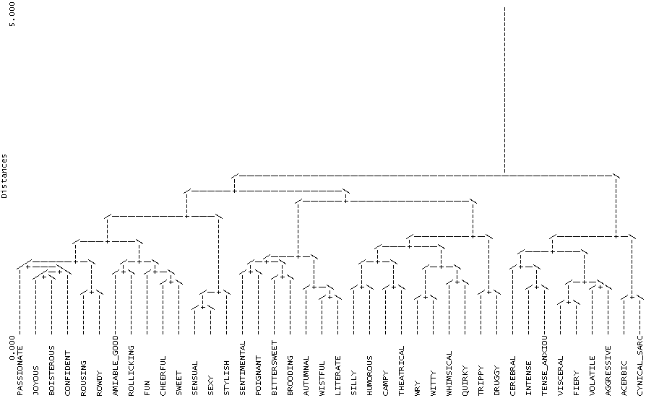
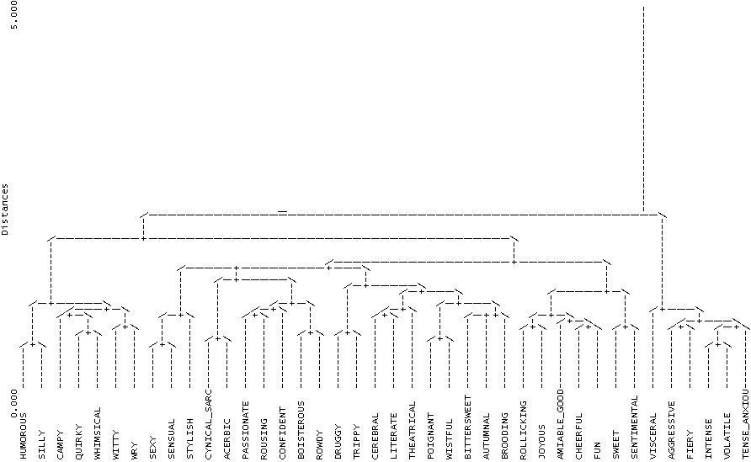
Mood Label Clustering
Mood labels for albums
Mood labels for songs
C1
C2
C3
C4
C5
C4
C1
C3
C2
C5
Hu, X., & Downie, J. S. (2007). Exploring Mood Metadata: Relationships with Genre, Artist and Usage Metadata. In Proceedings of International Society for Music Information Retrieval Annual Conference.

Slide 58
A Taxonomy of 5 Mood Clusters
Cluster_1:
passionate, rousing, confident, boisterous, rowdy
Cluster_2:
rollicking, cheerful, fun, sweet, amiable/good natured
Cluster_3:
literate, poignant, wistful, bittersweet, autumnal, brooding
Cluster_4:
humorous, silly, campy, quirky, whimsical, witty, wry
Cluster_5:
aggressive, fiery, tense/anxious, intense, volatile, visceral
Notes:
This taxonomy has been used in MIREX since 2007. You won’t really know how good or bad a taxonomy is until you start using it. We will cover studies based on this taxonomy when we talk about annotations in a few minutes.

Slide 59
Agenda
Million Mile View of Machine Learning
Machine learning and Data Science
Supervised vs. unsupervised learning
Decision Tree; Support Vector Machines (SVM); K-Nearest Neighbor (kNN)
Experimentation
Friendly ML Tools:
Weka: Machine learning
RapidMiner: Data mining
Case Studies
Audio Music Mood Classification Experiments (supervised)
Mood Label Clustering (unsupervised)
Wrap Up and Discussion

Slide 60
Most Important Take-Aways
Be fearless and have fun
Think spreadsheet for your data
A row for each thing in world you are interested in
One column to label the things in world
X number of columns for each FEATURE
For SUPERVISED ML one more column with GROUNDTRUTH
No magic feature set
More data is better!
N-fold to separate TRAIN and TEST data
Supervised vs. Unsupervised
Stay tuned for labs with more interesting cases ☺

